Slide 1
Soccer Quality by Country
Edmond Leahy

Slide 2
Dataset(s)
For this project, the European Soccer Database dataset was used.
https://www.kaggle.com/hugomathien/soccer

Slide 3
Motivation
In the soccer world, the English Premier League is often said to be the best soccer league to watch in terms of quality. I have heard this all my life, while wondering if this was true. I have watched many soccer games from many countries, and have found that other leagues are just as exciting to watch, if not more exciting. I wanted to find out what the data showed.

Slide 4
Research Question(s)
Is the English Premier League (EPL) the most exciting soccer league in the world to watch, in terms of goals per game?

Slide 5
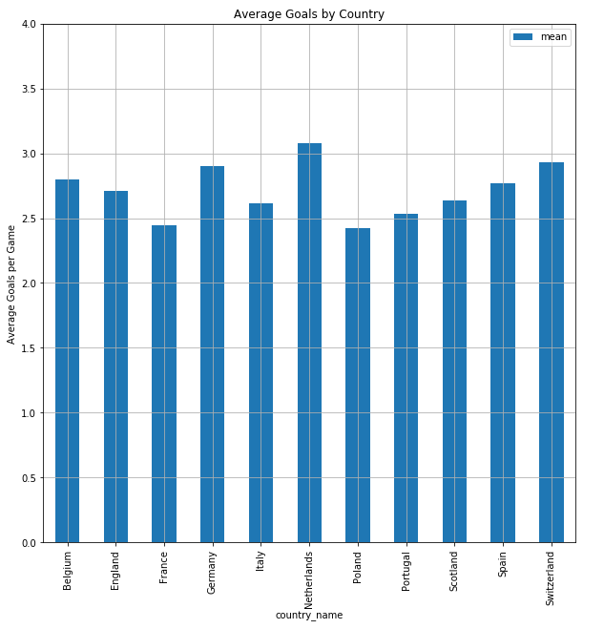
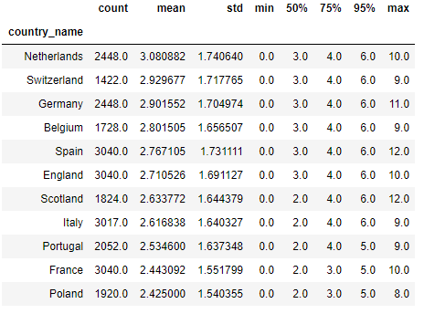
Findings –Goals Per Game(1)
The results of grouping the dataset by country gave the following results for number of goas per game average:

Slide 6
Findings –Goals Per Game(1)

Slide 7
Acknowledgements
Did you use other informal analysis to inform your work? Did you get feedback on your work by friends or colleagues? Etc.
If you had no one give you feedback, it’s okay to say that.

Slide 8
References
If applicable, report any references you used in your work. For example, you may have used a research paper from X to help guide your analysis. You should cite that work here. If you did all the work on your own, please state this.

